Slide 1

From Finger stick blood glucose samples to the predictive power of continuous glucose monitoring
Alessia Bruzzo, Antoine Biebuyck, Nathan Hoffman

Slide 2

Motivation
~90%
Patients with type II [1]
Less than half
537 Million
Meet glycemic targets [2]
Adults (20-79) in 2021 [1]
79.4%
Only 1 in 4
Live in low- & middle- income countries [1]
Insulin-treated T2D use CGM [2]
3 Times
Price of CGM versus finger prick in US study [3]

Slide 3
metrics
Mean Blood glucose level
Current gold standard for determining management [4]
A1C measures average blood glucose over previous months [4]
Target is less than 154 mg/dL [5]
Time In range
Healthy range considered 70-180 mg/dL and aim is to spend 70% of time in this range [4]
Below is hypoglycemia and above is hyperglycemia
More time spent in range, less likely to develop complications [4]

Slide 4
Interpolation Methods
Cubic Spline
Process of constructing a spline (function values of an interpolation function) within a certain interval and consists of n polynomials of degree 3 [6]
Polynomial of degree 5
A single polynomial function with a highest order of 5

Slide 5
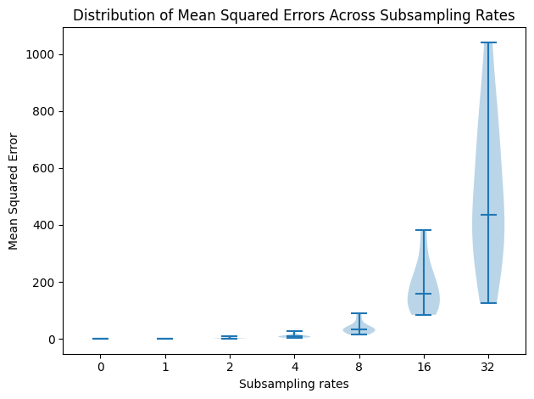
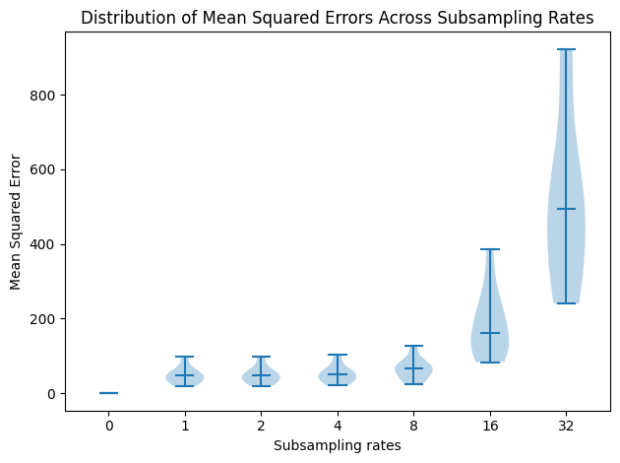
Mean Squared Error
CubiC Spline
Polynomial Degree 5

Slide 6
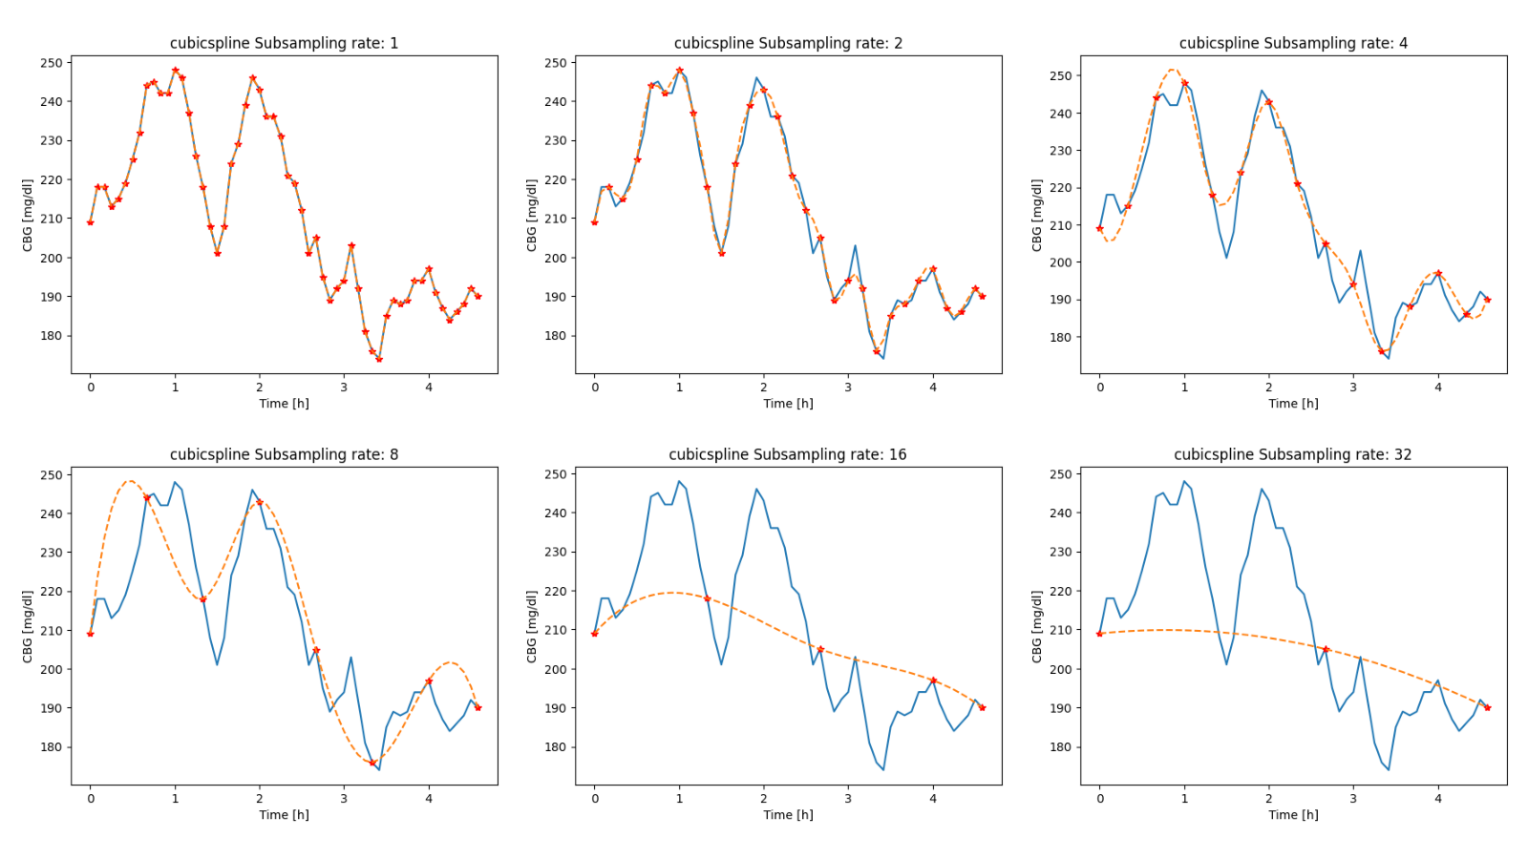
Reconstructed Signal

Slide 7
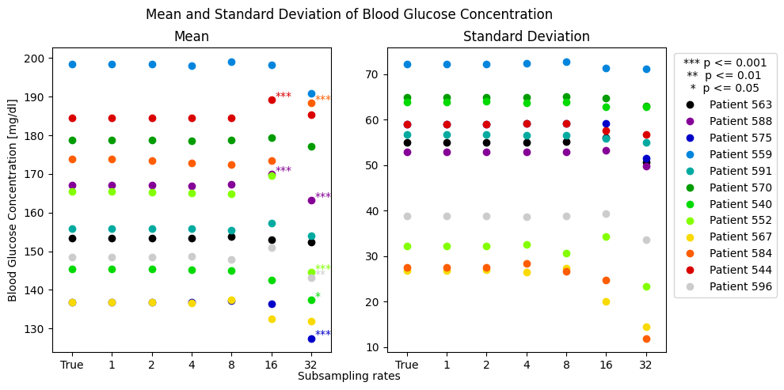
Mean blood glucose level

Slide 8
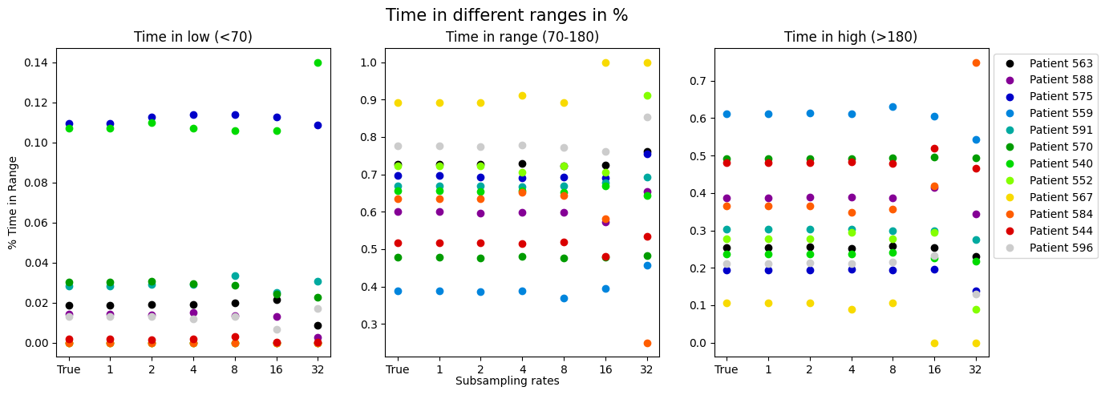
Time in range

Slide 9
Conclusions
Satisfactory reconstructions up until intervals of 40 minutes
Would therefore require 24 finger prick samples a day
Not quite convenient and likely unsustainable

Slide 10
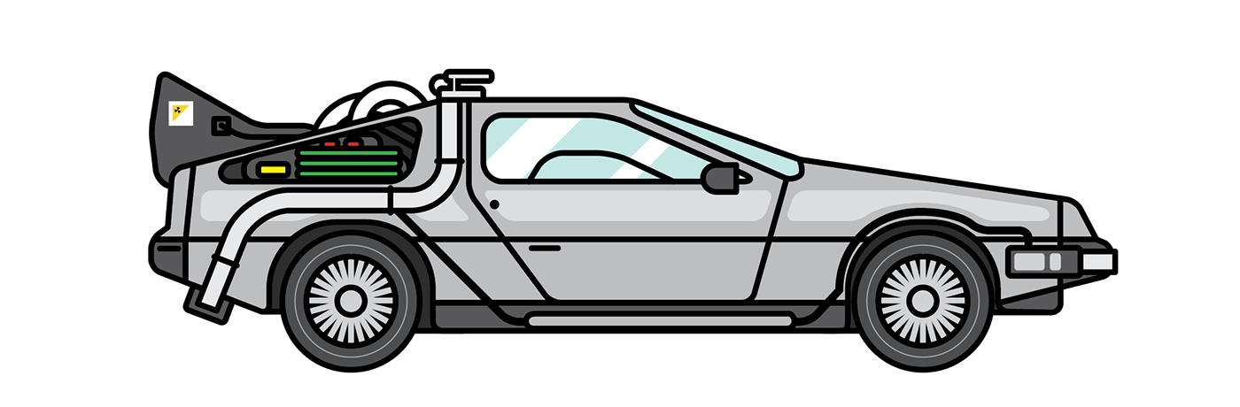

Future directions
Adaptive or dynamic subsampling
Using additional features that can be measured non-invasively using wearables
Use of artificial intelligence and machine learning

Slide 11
References
[1] Home et al., “IDF Diabetes Atlas.” Accessed: Dec. 14, 2024. [Online]. Available: https://diabetesatlas.org/
[2] L. S. Mayberry, C. Guy, C. D. Hendrickson, A. B. McCoy, and T. Elasy, “Rates and Correlates of Uptake of Continuous Glucose Monitors Among Adults with Type 2 Diabetes in Primary Care and Endocrinology Settings,” J GEN INTERN MED, vol. 38, no. 11, pp. 2546–2552, Aug. 2023, doi: 10.1007/s11606-023-08222-3.
[3] W. Wan et al., “Cost-effectiveness of Continuous Glucose Monitoring for Adults With Type 1 Diabetes Compared With Self-Monitoring of Blood Glucose: The DIAMOND Randomized Trial,” Diabetes Care, vol. 41, no. 6, pp. 1227–1234, Jun. 2018, doi: 10.2337/dc17-1821.
[4] American Diabetes Association. CGM and Time in Range, American Diabetes Association. url: https : / / diabetes . org / about - diabetes / devices-technology/cgm-time-in-range.
[5] “Understanding A1C Test | ADA.” Accessed: Dec. 14, 2024. [Online]. Available: https://diabetes.org/about-diabetes/a1c
[6] “Cubic Spline Interpolation - Timo Denk’s Blog.” Accessed: Dec. 14, 2024. [Online]. Available: https://blog.timodenk.com/cubic-spline-interpolation/

Slide 12
EnD

